Slide 1
NUBISAVE: CLOUD STORAGE CONTROLLER
Prof. Gopinath.M.P
Dr. Ing Josef Spillner
By
Saketh P(10bce0495)

Slide 2
Aim
In this project, as a part of the FlexCloud Research Project we demonstrate the usage and maintenance of public data as a group through C++(code) whose front end is shown in the application to connect between devices and deploy storage access through the Nubisave feature and maintenance which is a part of real time hardware department and testing its vitality on data end users who would like to store their data and upload or connect their cloud online data drives to their desktop system through data sharing over the internet.

Slide 3
INTRODUCTION
Cloud storage (enterprise/customer) level is something that involves logical pooling of really digital data. Like all other physical data and servers owned and maintained by companies, this is one such development to ensure safety and security which are the high necessities of cloud storage achieved through Nubisave (frontend) to visualize and parameterize the data effective to it.

Slide 4
OBJECTIVES
To demonstrate the working and development of Nubisave (the cloud storage system) and connections to cloud servers
To compare its architecture to a real distributed system architecture and perform performance analysis and take the results through its data unit.
To let out an actual prototype to show its functioning, process and the storage of the file system that makes data storage and validation possible in this unit.

Slide 5
FUSE
In cloud computing, FUSE (FileSystem in UserSpace) is an operating system that allows non privileged users create their own file systems without the need to alter the already existing Kernel code. It plays its role as a bridge to the real or the direct Kernel interfaces by running the file code in the user space. It is majorly used for creating VFS (virtual file systems), they don’t actually save data rather translate the existing file system into a device.

Slide 6
Cache Parallelism
Memory level Parallelism or cache parallelism is the system’s ability to have
Memory operations left over, more cache misses can occur at the same point of time.
Much cache parallelism is reflected in multiprocessor or multithreaded system environment, but actually happens over a single process.

Slide 7
Cloud Storage Controller
Now, pushing ourselves deep into the subject cloud storage controllers are ones used to store data and ease anxiety or any kind of pressure on actual data clouds.It means that we spend less money and store more data.
The main advantage of the cloud storage controller is its file system. Its payload data and the metadata are separated with a logical and a physical separation between them which makes the extraction of metadata very easy and transfer it in the most simplest ways possible.
Navigation is also made simple with the existence of Cloud storage controller. In this the user can easily retrieve his data irrespective of what the person maintaining it follows and Nubisave is also an example of the cloud storage controller which makes work for the user as easy as it can get. Let us go into the first phase of the project where we learn and demonstrate the creation and working of this application.

Slide 8
Phase I: Creation and demonstration
Working
Configuration
Cloudfusion can be configured in a couple of ways,
Graphically from Nubisave using an authentication on to the server.
From the editor to permit it to access it into a local device in your computer

Slide 9
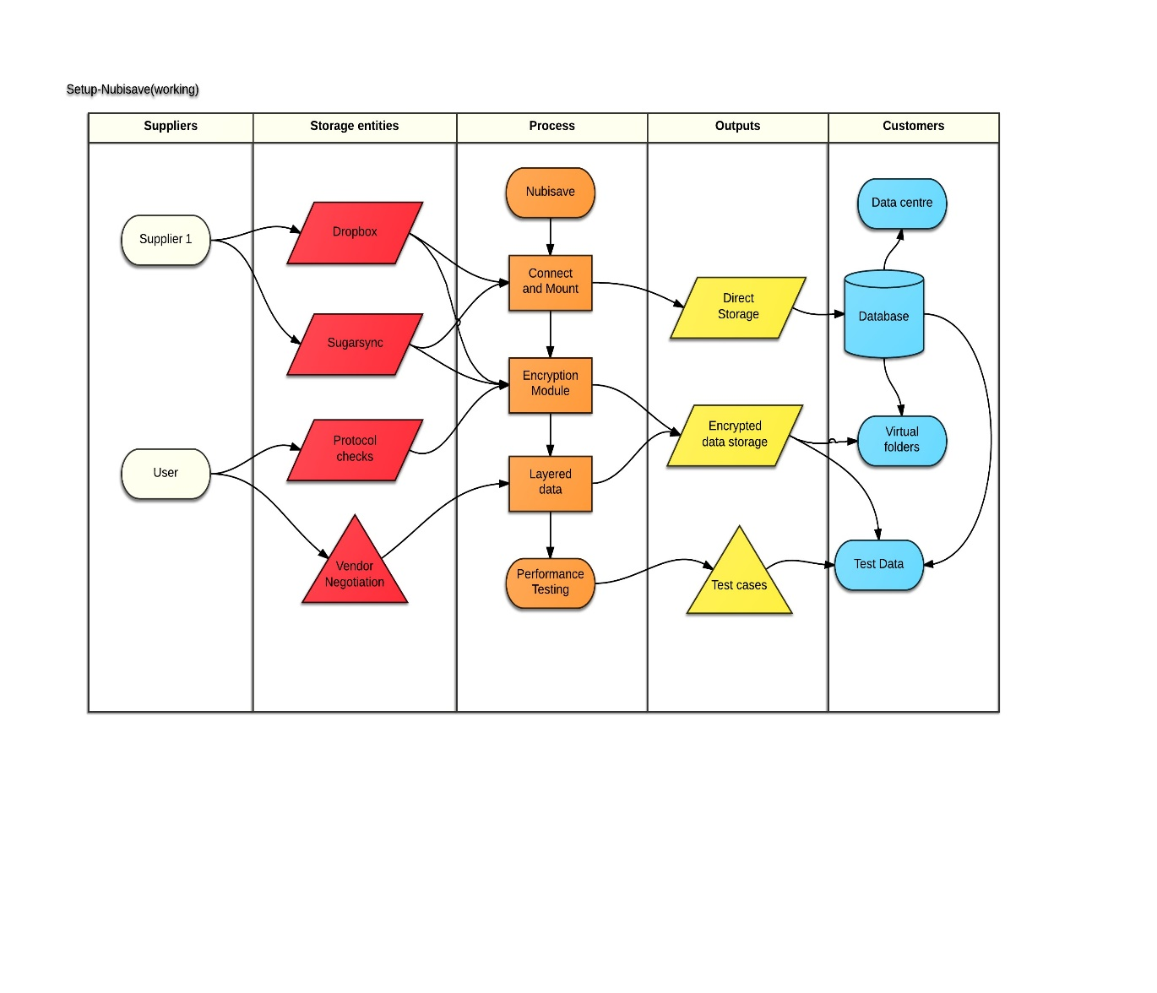
Activity Diagram on the working model

Slide 10
Problem with the existing system
In a normal cloud computing system, there are a few redundancy issues to be addressed. So, we try to move on to a cloud storage controller.
There is no organized way of storing, rather only chunks of data is directly stored.
When we try to separate the normal data from the system, it has to involve a tinker in the metadata and through this we can easily retrieve any data we like without altering any other interior storage.
The response time to reach or save the data is very high in a normal cloud system.

Slide 11
Phase II : Architecture and Performance testing
The task of NubiSave team is to develop an integrated desktop, cloud provider-wide tool so that the backup on heterogeneous cloud storage services are controlled with regard to the nature backup data. This requires a cloud abstraction and Selection component and a graphical front-end to be implemented for providers across to select the appropriate service storage. Through this service platform, a user-friendly manner is being created, its data redundantly at different storage provides stores, so that a significantly larger security server failure doesn’t arise.

Slide 12
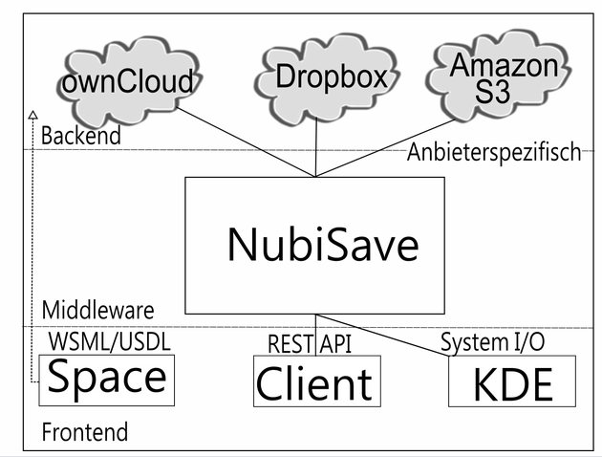
EXTERNAL ARCHITECTURE

Slide 13
Working
For example, while dealing with an organization through Nubisave one such encountered case will be demonstrated below. When a provider is willing to pay a certain amount of price for the storage service he has to fill in details in the box that follows.

Slide 14
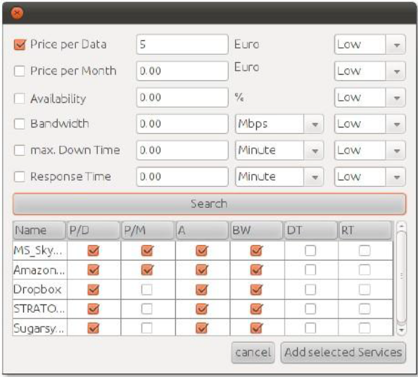
ATTRIBUTES

Slide 15
Performance Testing
To understand the progress of the system is to allow the performance of it and see how efficiently it works in overhead and faulty cases. In the following example we perform speed testing, the access of the data in rewrites on a memory block can be understood here from these cases.

Slide 16
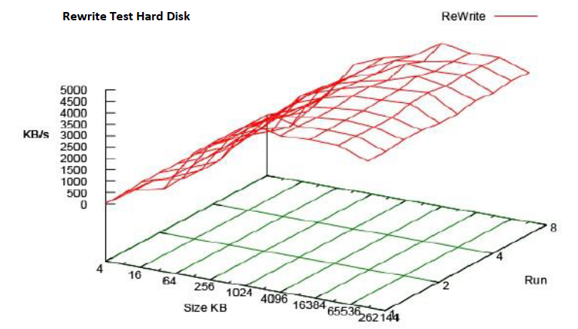
Rewrite test on hard disk

Slide 17
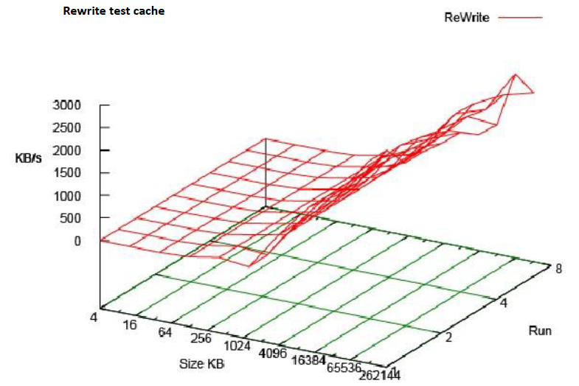
Rewrite test on cache

Slide 18
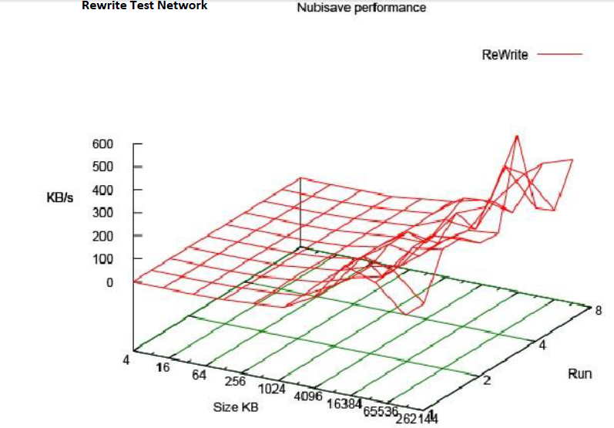
Rewrite test on the network

Slide 19
Actual Prototype and Functioning
Implementation (Presentable modules)
In this we see some important features that let us understand how to
Mount/Unmount cloudfusion
Rebuild Nubisave on to the system.
An .ini file of dropbox
Understanding Gitorious(a complete maintenance and collaboration system)

Slide 20
Gitorious
When you act as a collaborator to the team of the development of a system, Gitorious allows you to maintain it as code repository or a GIT repository for all your files which can be hosted on for the others to view and make changes on them. Let us see a part of the other team members sharing it over the software to access easily for a personal or professional use.

Slide 21
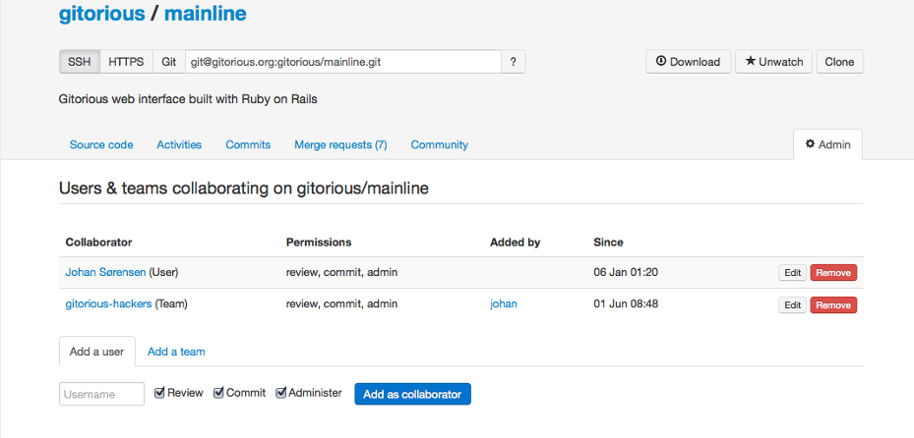
Gitorious

Slide 22
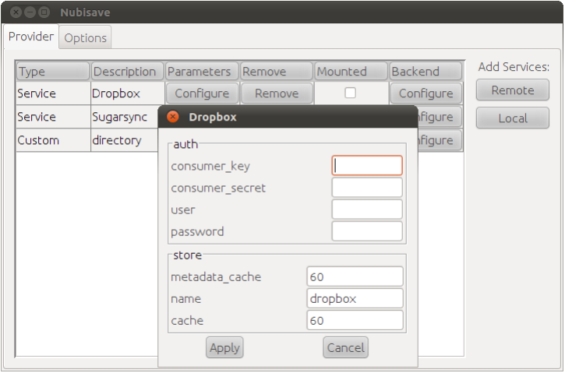
CLOUD CONFIGURATION

Slide 23
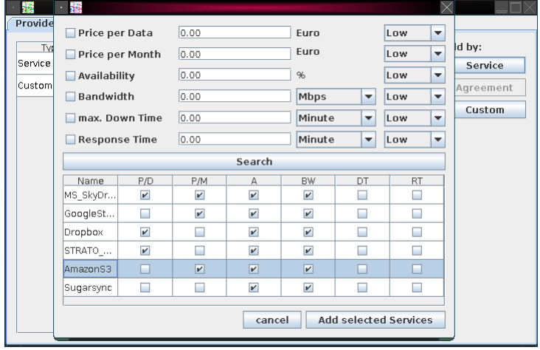
Non Functional Properties

Slide 24
Conclusion and Result
Through these results we can understand that it has been a very comfortable layout for its data on various storage providers. As it follows a modular system, it is provided with more functionality. It is important to once again note that there can be direct contact to the vendors through the GUI or Nubisave itself. When you register yourself separately you can store data in Nubisave through that. A protocol that can allow the user and the company direct access to the system through Nubisave is the WS-Information Protocol.

Slide 25
References
Josef Spillner, Alexander Schill, and Cordelia Schmid. :Toward Dispersed Cloud Computing 2010: 259-451
Josef Spillner, Johannes Schad, Stephan Zepezauer . :Personal and Federated Cloud Mangement Cockpit. Praxis der Informationsverarbeitung und Kommunikation 36(1):44(2013)
[3] Josef Spillner, Alexander Schill: Orchestration of Distributed Storage Targets through Storage Flows. CloudCom (2) 2013: 349-354
[4] Josef Spillner, Johannes Müller, Alexander Schill: Creating optimal cloud storage systems. Future Generation Comp. Syst. 29(4): 1062-1072 (2013)
[5] Josef Spillner, Alexander Schill: π-Control: A Personal Cloud Control Centre. CoRR abs/1202.0970 (2012)

Slide 26
THANK YOU

